Slide 1
Credit Approval
Analysis and Recommendations
Lynn Majerome

Slide 2
TOC
Overview
Analysis
Recommendations
Summary and Conclusion

Slide 3
Overview
This project aimed to delve into a dataset containing financial information of clients of our Bank, HereIsTheMoney Bank

Slide 4
Analysis
1
Summary Statistics Analysis: performed basic statistics and identified outliers in the data.
3
Distribution Analysis: created visualizations for each column.
2
Data Cleaning: dealt with missing values, duplicates, mistyped and unnecessary columns.
4
Raising Data Questions: about age, annual income, occupation etc.
5
Data Enrichment (Recommendations): How to improve data

Slide 5
Objective
Identify factors that influence clients’ ability to meet their financial obligations

Slide 6
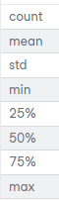
Summary Statistics Analysis
Performed basic statistical analysis
Identified columns with outliers
Notes:
Column DAYS_EMPLOYED has 97300 outliers
Column AMT_INCOME_TOTAL has 19108 outliers
***
Column CNT_CHILDREN has 6075 outliers
Column CNT_FAM_MEMBERS has 5690 outliers
***
Column FLAG_WORK_PHONE has 90401 outliers
Column FLAG_EMAIL has 47455 outliers
***

Slide 7
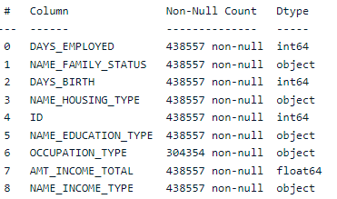
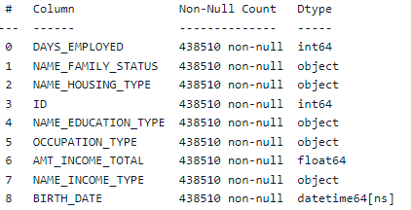
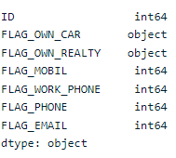
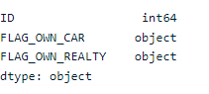
Data Cleaning
Before
After
Addressed
Missing values
Duplicates
Mistyped columns
Unnecessary columns
*****
Before
After

Slide 8
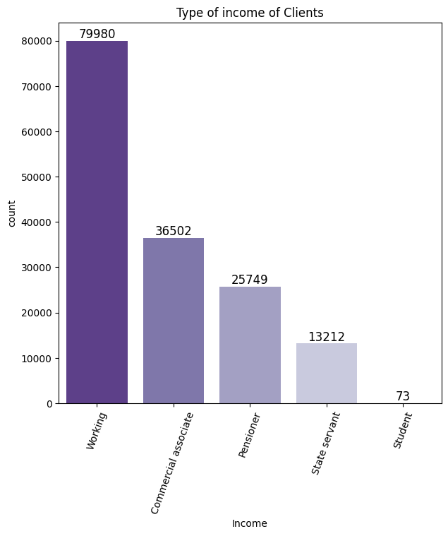
Distribution Analysis
Create visualization for each column

Slide 9
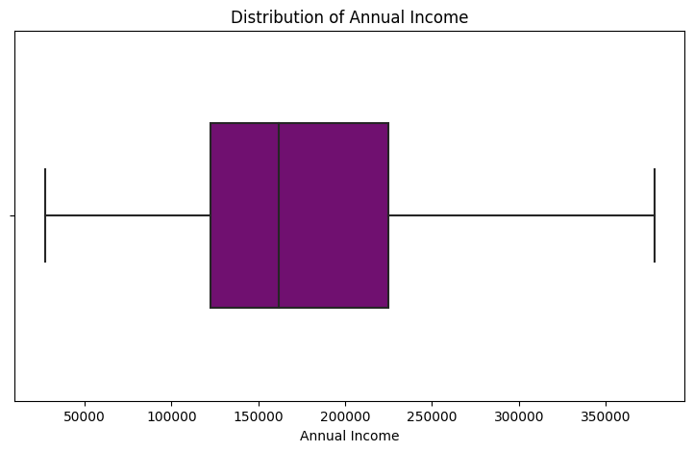
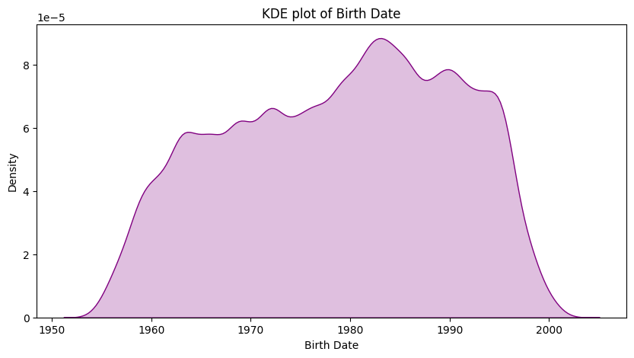
Distribution Analysis

Slide 10
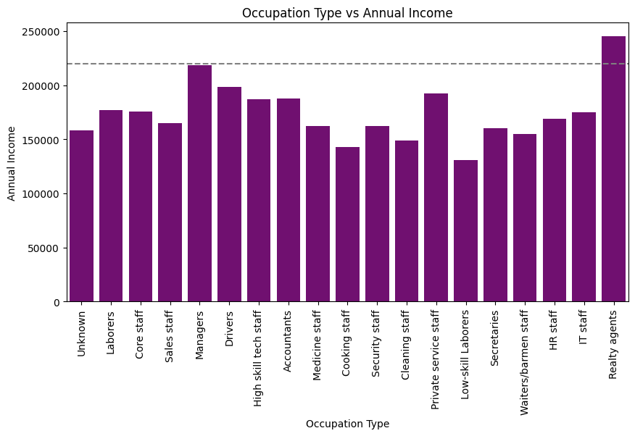
Cross-Correlation Analysis
Checking columns against each other other in order to see correlation (if any) among columns

Slide 11
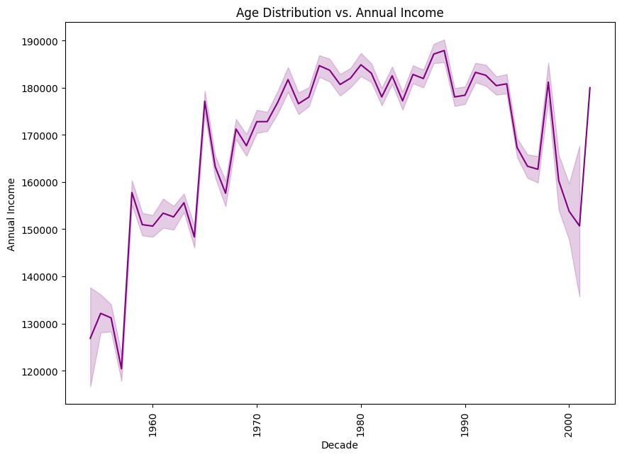
Cross-Correlation Analysis
Checking columns against each other other in order to see correlation (if any) among columns

Slide 12
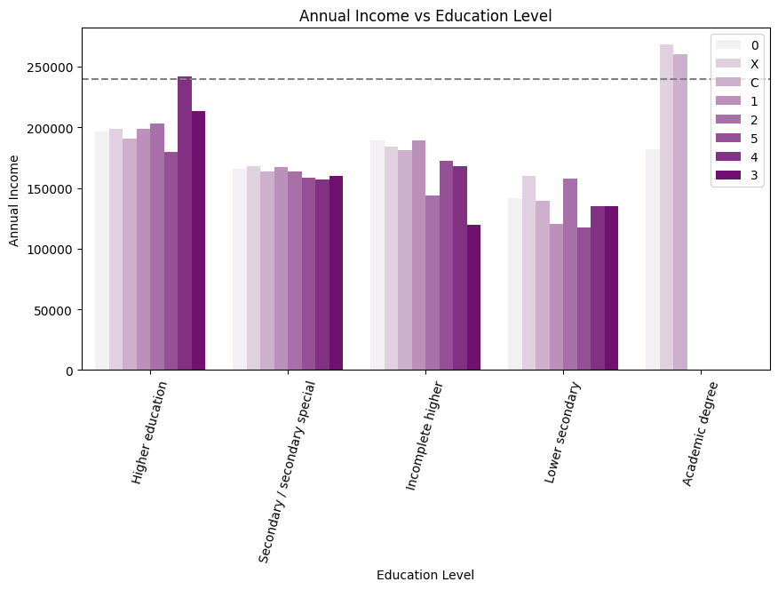
Cross-Correlation Analysis
Checking columns against each other other in order to see correlation (if any) among columns

Slide 13

Raising Data Questions
What is the annual income distribution?
Correlation between occupation type and loan status?
Correlation between age and annual income?
Correlation between homeownership and loan status?

Slide 14
Recommendations

Slide 15
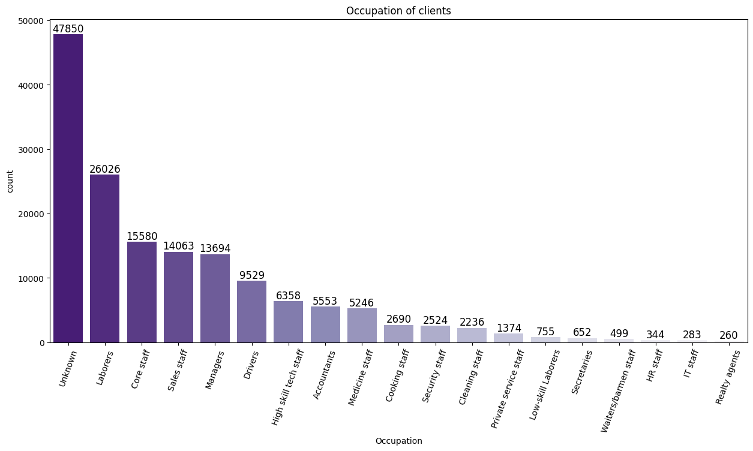
Recommendation
01
Obtain Missing Occupation Types:
Occupation critical in assessing risk associated with lending to certain clients;
Can provide valuable insight into a client's type of work, income level, and likelihood of default.

Slide 16
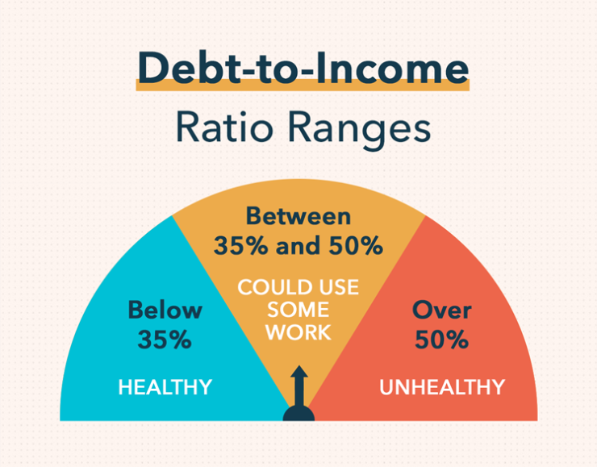
Recommendation
02
Investigate Known and Additional Asset Values
Lack information on value of the assets (home/car);
Additional assets such as savings and real estate investments as well as liabilities.

Slide 17

Recommendation
03
Consider Clients Location:
Lack of information on clients’ location;
Can be used to determine a client's disposable income and socio-economic status.

Slide 18

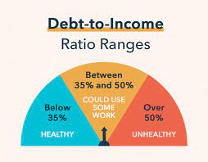
Conclusion
To further enhance our understanding of our clients' ability to meet their obligations, it would be beneficial to consider factors such as occupation, debt-to-income ratio and location. This information, when combined with our existing data, will provide a more comprehensive analysis of our clients' financial health, enabling us to make more informed decisions about lending.
Notes:
Sources
Family: https://www.google.com/search?q=family+picture+public+domain&source=lnms&tbm=isch&sa=X&ved=2ahUKEwiawaain4L9AhWekIkEHcRmCfAQ_AUoAXoECAEQAw&biw=1920&bih=969&dpr=1#imgrc=_vMFrbNZ6O2h6M
Occupation: https://stock.adobe.com/ca/364843654?clickref=1011lwwImbW2&mv=affiliate&mv2=pz&as_camptype=&as_channel=affiliate&as_source=partnerize&as_campaign=vkra
Debt to income: https://mint.intuit.com/blog/planning/debt-to-income-ratio/
Location: https://publicdomainvectors.org/en/free-clipart/Map-location-icon-vector-image/13647.html

Slide 19
Thank you.

